Slide 1
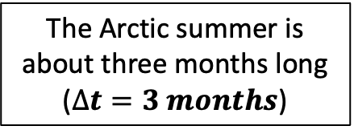





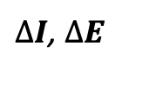
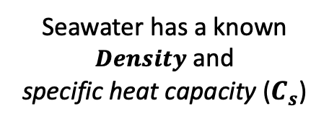
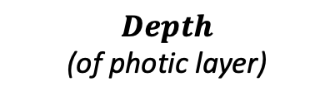
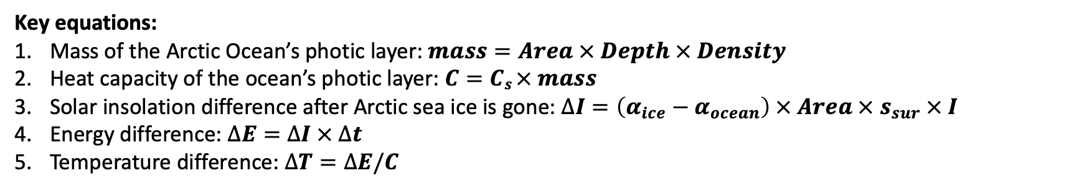
In the Ice-Free Arctic CGI, there are a lot of crazy units – but fortunately, Python has pint
clouds

Slide 2

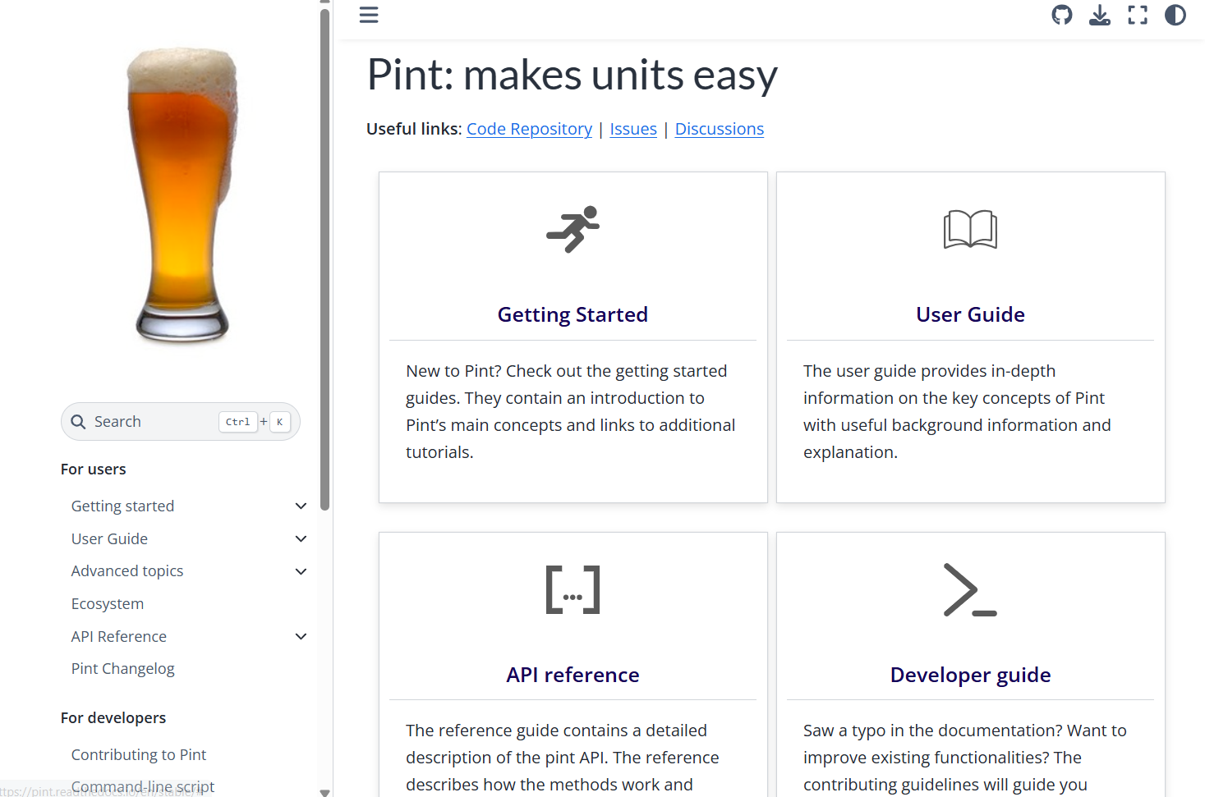
In the Ice-Free Arctic CGI, there are a lot of crazy units – but fortunately, Python has pint
clouds

Slide 3
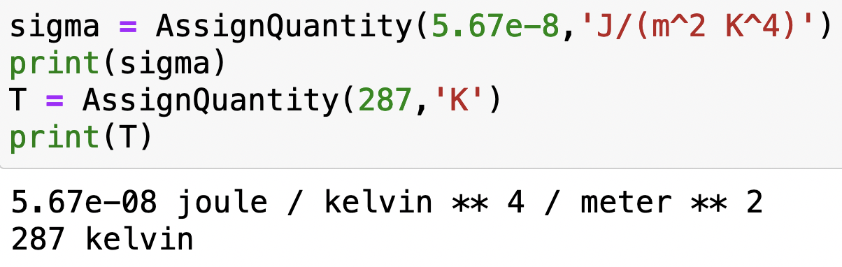
Using pint
Here’s how you bring pint into your Python notebook
Super-handy because AssignQuantity attaches units for you:

Slide 4
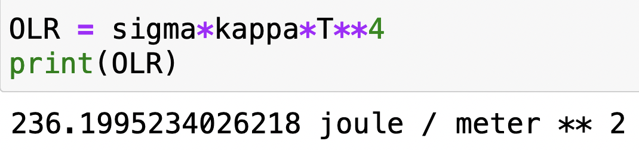
Using pint
pint also calculates units of the results of calculations:

Slide 5
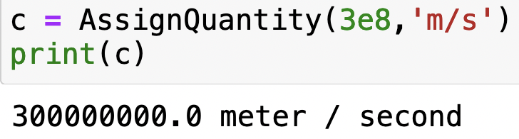
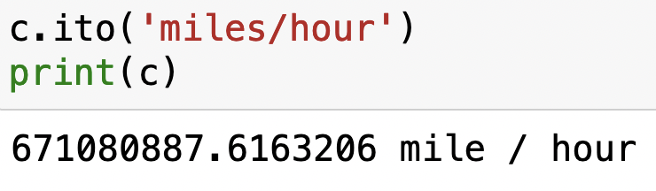
Using pint
pint can also do conversions for you, using “.ito”

Slide 6
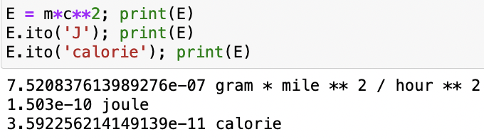
Using pint

Slide 7
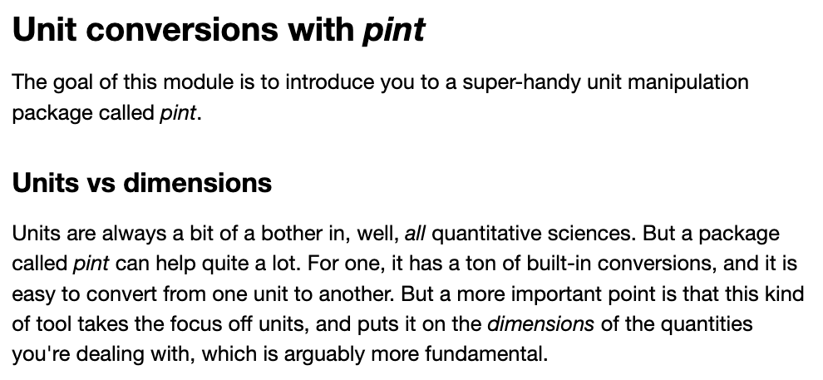
OK, let’s get started

